Slide 1
Best Health Website specification
BSE Web Devs

Slide 2
Project overview
Provide secure therapy sessions, informative blogs, mental health self-assessment, and RSS updates.
Promote mental wellness through digital accessibility.
Reach vulnerable populations (youth, people with personal challenges, elderly) and provide mental health guidance

Slide 3
Content Goals
Public Interest Content
Mental health and wellness information accessible to general public.
E-commerce
Booking therapy sessions with payment gateways.
Portal Features
User authentication and role-based access (therapist vs. public user views).
Blog Content
Therapist-written articles for mental health education.
RSS Feed
Automatic content distribution of blog updates.

Slide 4
Content goals (cont’d)
*Include screenshots of the website features that demonstrate the content goal/s stated.
From specifications
Include screenshots of Blog section, Therapist booking interface and User login dashboard

Slide 5
Target Audience
Age Groups:
Primary: Young adults (18-35 years)
Students with academic pressures
Young professionals with work-life balance issues
Secondary: Middle-aged adults (36-55 years)
Gender Distribution:
Inclusive approach for all gender identities
Nationality:
Primary: Fiji national population (suburban areas)
Secondary: Rural communities (via articles/videos)
Tertiary: International users seeking remote support

Slide 6
Audience Needs & challenges
Challenges:
Academic and work stress
National stigma
Lack of mental health professionals
Solutions:
Secure and private sessions
Easy navigation and accessibility
Affordable or free options
Transparent security measures

Slide 7
Site Pages
Home Page: Brief introduction of the system, latest articles and booking appointments
Therapists Page: List of all therapists
Specific Therapist Page: Individual therapist profiles
Blogs Page: List of all articles ordered by publish date
Specific Blog Page: Individual articles by specialized therapists
Login/Sign Up Page: User authentication
Self-Assessment Quiz Page: Mental health evaluation tool
Quiz Results Page: Assessment outcome and recommendations
Book Session Page: Appointment scheduling

Slide 8
Site Pages Reasoning
Home page: Introduces the service and provides initial engagement.
Therapist pages: Allows users to browse and select specialists that suit their needs.
Blog pages: Provide helpful insights and build trust with users through professional advice.
The booking page: Enables users to schedule therapy at their convenience, supporting mental health proactively.
Self-assessment quizzes: Help users reflect on their wellbeing before committing to a session.
A login/sign-up page: Ensures secure access for users.

Slide 9
Core Functionality
Booking System
Appointment scheduling with therapists
Gift session option
Carousel scrolling for therapist selection
Search functionality
Implementation: Database-driven booking system with payment processing
User Authentication
Credential-based login
Social login options (Google)
Implementation: Secure authentication system with password hashing
Gifting Sessions
Friend-to-friend session gifting
Implementation: Custom e-gift system with notification

Slide 10
Functionality workflow

Slide 11
Omitted Functionality
**Let me know what functions we didn’t have here.

Slide 12
Security Measures
Blog Post Validation
Administrator review process
24-hour cooldown period
Content moderation system
Password Hashing
SHA-256 algorithm implementation
Protection against database breaches
Server-side hashing of user credentials
SSL Certificate
Secure data transmission
Public-key cryptography
HTTPS protocol with lock icon indicator

Slide 13
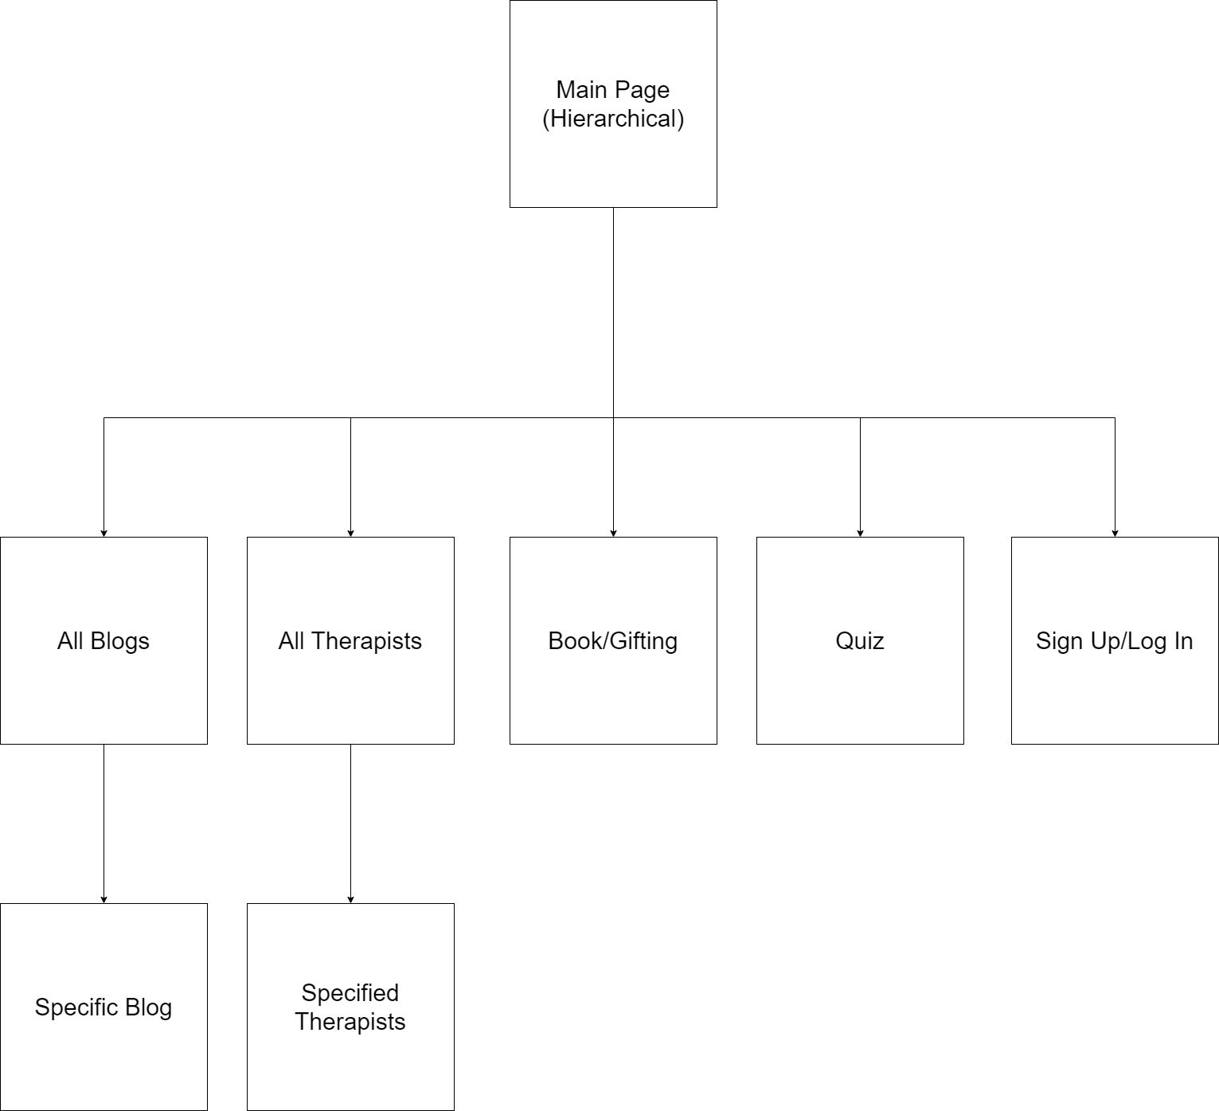
Site structure
Structure type: Hierarchical
Core area:
Therapists
Blogs
Bookings

Slide 14
Site navigation
Where am I?
Fixed navigation bar with highlighted current page.
Bold font weight and underline for active links.
Screenshot: Navigation bar showing active state.

Slide 15
Site navigation (Cont’d)
Where can I go?
Clear visibility of available links in navigation menu.
Hero, services, and call-to-action sections on home page.
Screenshot: Full navigation menu options.

Slide 16
Site navigation (Cont’d)
How do I get there?
Fixed position navigation bar on all pages
Simple menu labels using plain, non-clinical language
Screenshot: Navigation elements with labels

Slide 17
Site navigation (Cont’d)
How do I get back to where I started?
Persistent home link in navigation
Browser back button compatibility
Screenshot: Home button placement

Slide 18
Website layout
Colour Scheme:
White (#FFFFFF)
Slate Blue (#001e2b)
Forest Green (#00684a)
Spring Green (#00ed64)
Typography:
Body
Headings

Slide 19
Website layout (Cont’d)
Home Page Layout:
Show Wireframes to actual screenshots.

Slide 20
Website layout (cont’d)
Therapists Page Layout:
Show Wireframes to actual screenshots.

Slide 21
testing
Browsers Tested:
Google Chrome
Firefox
Safari
Microsoft Edge
Best-performing browser: Google Chrome
Compatibility Issues:
Safari

Slide 22
Testing (cont’d)
SS of stuff not rendering

Slide 23
Promotional Video

Slide 24
Summary
SAS will save money and time in the long term.
SAS uses modern and secure technologies.
SAS puts the user first (AI chatbot).
SAS features will attract new students and staff.

